Slide 1
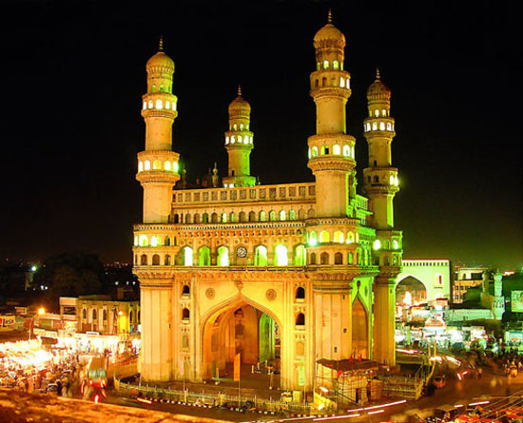
Analysis of the Common Venues in Hyderabad City
Capstone Project
Kolla Ravikanth Yadav

Slide 2
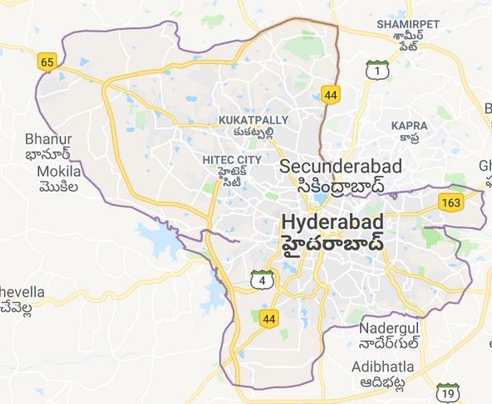
Introduction
History of Hyderabad
Hyderabad is the capital of the Indian state of Telangana. It is a historic city noted for its many monuments, temples, mosques and bazaars. A multitude of influences has shaped the character of the city in the last 400 years.
The city is forming its role and outlook as part of the booming service industry revolution, and is trying to preserve and popularize its history.
The History of this city, has deeply affected the culture, language, and cuisine of the people living here, and the areas once part of Hyderabad state.
Hyderabad is the capital of southern India's Telangana state. A major center for the technology industry, it's home to many upscale restaurants and shops. Its historic sites include Golconda Fort, a former diamond-trading center that was once the Qutb Shahi dynastic capital. The Charminar, a 16th-century mosque whose 4 arches support towering minarets, is an old city landmark near the long-standing Laad Bazaar.

Slide 3
Problem Statement
If we are to consider an business or investment opportunity to open or expand in Hyderabad City
•What is an optimum location in a budget?
•Which kind of service is the best
Data Gathering
To choose a right location and serving type, effective data analysis is essential.
Data we collected are:
1.Demography of different location – (https://mygov.in/)
2.Restaurants and their types in different locations
3.Cuisine type served by competitors or restaurants

Slide 4
Methodology
Methodology
Data Cleaning
Data Filtering
Data Transformation
Data Visualization and Analysis
Clustering

Slide 5
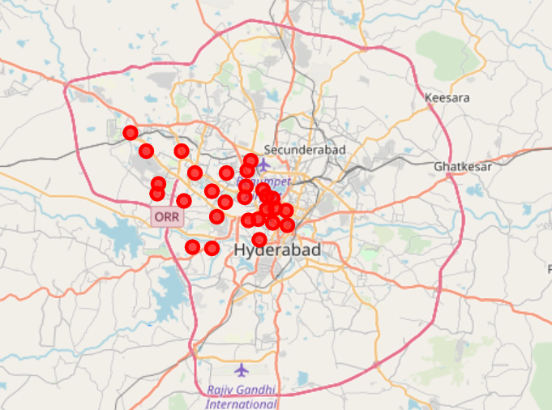
Hyderabad City Neighbourhood Map

Slide 6
Hyderabad City Neighbourhood Services
ATM
Andhra Restaurant
Arts & Crafts Store
Asian Restaurant
Athletics & Sports
Bakery
Beer Garden
Boutique
Breakfast Spot
Burger Joint
Bus Station
Cafeteria
Café
Chaat Place
Chinese Restaurant
Clothing Store
Coffee Shop
College Rec Center
Convenience Store
Deli / Bodega
Department Store
Dessert Shop
Donut Shop
Electronics Store
Etc.. There are around 84 various service providers in the neighbourhood

Slide 7
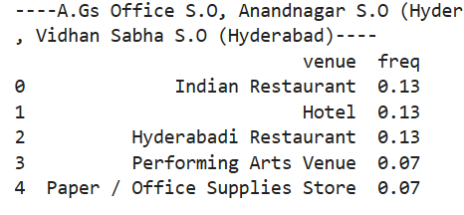
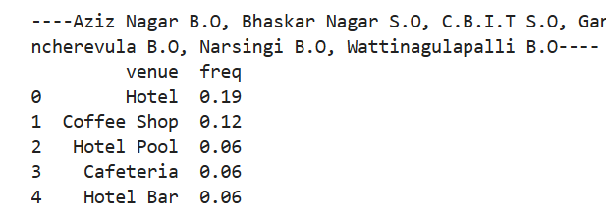
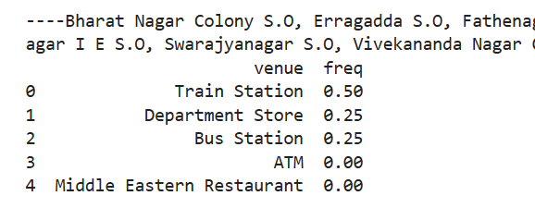
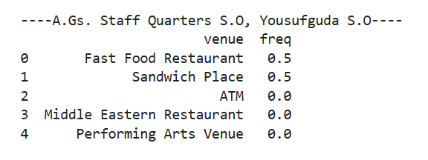
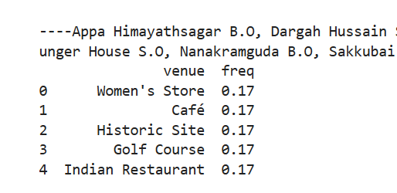
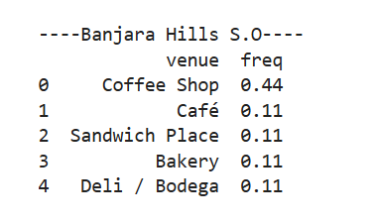

Slide 8
Conclusion
1. More than 39% of the Restaurants are located in around A.Gs Office S.O, Anandnagar S.O (Hyderabad), Bazarghat S.O (Hyderabad), Khairatabad H.O, Parishram Bhawan S.O, Vidhan Sabha S.O (Hyderabad).
2. There are No ATMs in around A.Gs. Staff Quarters S.O, Yousufguda S.O.
3. Very few Food restaurants in around A.Gs. Staff Quarters S.O, Yousufguda S.O
4. 17% of them are Women stores in around Appa Himayathsagar B.O, Dargah Hussain Shahwali B.O, Golconda S.O, Hyder Shah Kote B.O, Kakatiya Nagar S.O, Lunger House S.O, Nanakramguda B.O, Sakkubai Nagar S.O, Toli Chowki S.O
5. 21% of them are hotels and coffee shops Aziz Nagar B.O, Bhaskar Nagar S.O, C.B.I.T S.O, Gandipet B.O, Himayathnagar B.O, Janwada B.O, Kokapet B.O, Mancherevula B.O, Narsingi B.O, Wattinagulapalli B.O
6. Banjara hills has more than 44% of them are Coffee shops.
.

Slide 9
Thank You!!!

